Slide 1
The promise and history of viral load use and scale up for patient management and surveillance
AIDS 2018
Amsterdam
July 25, 2018

Slide 2
History of guideline changes for VL as a treatment failure monitoring tool
2002 | Not recommended
2003 | Not recommended (but desirable)
2006 | WHO advocates wider access in tertiary centres and simpler tests
2010 | Recommended to confirm failure (phase in approach)
2013 | Recommended as preferred way to diagnose failure
2016 | Recommended as preferred way to diagnose failure; DBS (phase out routine CD4 monitoring)

Slide 3
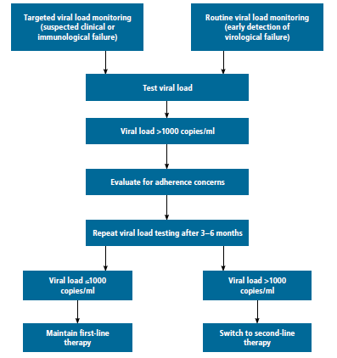
2016 WHO ARV Guidelines for treatment failure monitoring
Notes:
Mention the times for VL: 6 months, 12 months, then yearly

Slide 4
2016 WHO ARV Guidelines recommends the use of dried blood spot specimens can be used, increasing access to VL

Slide 5
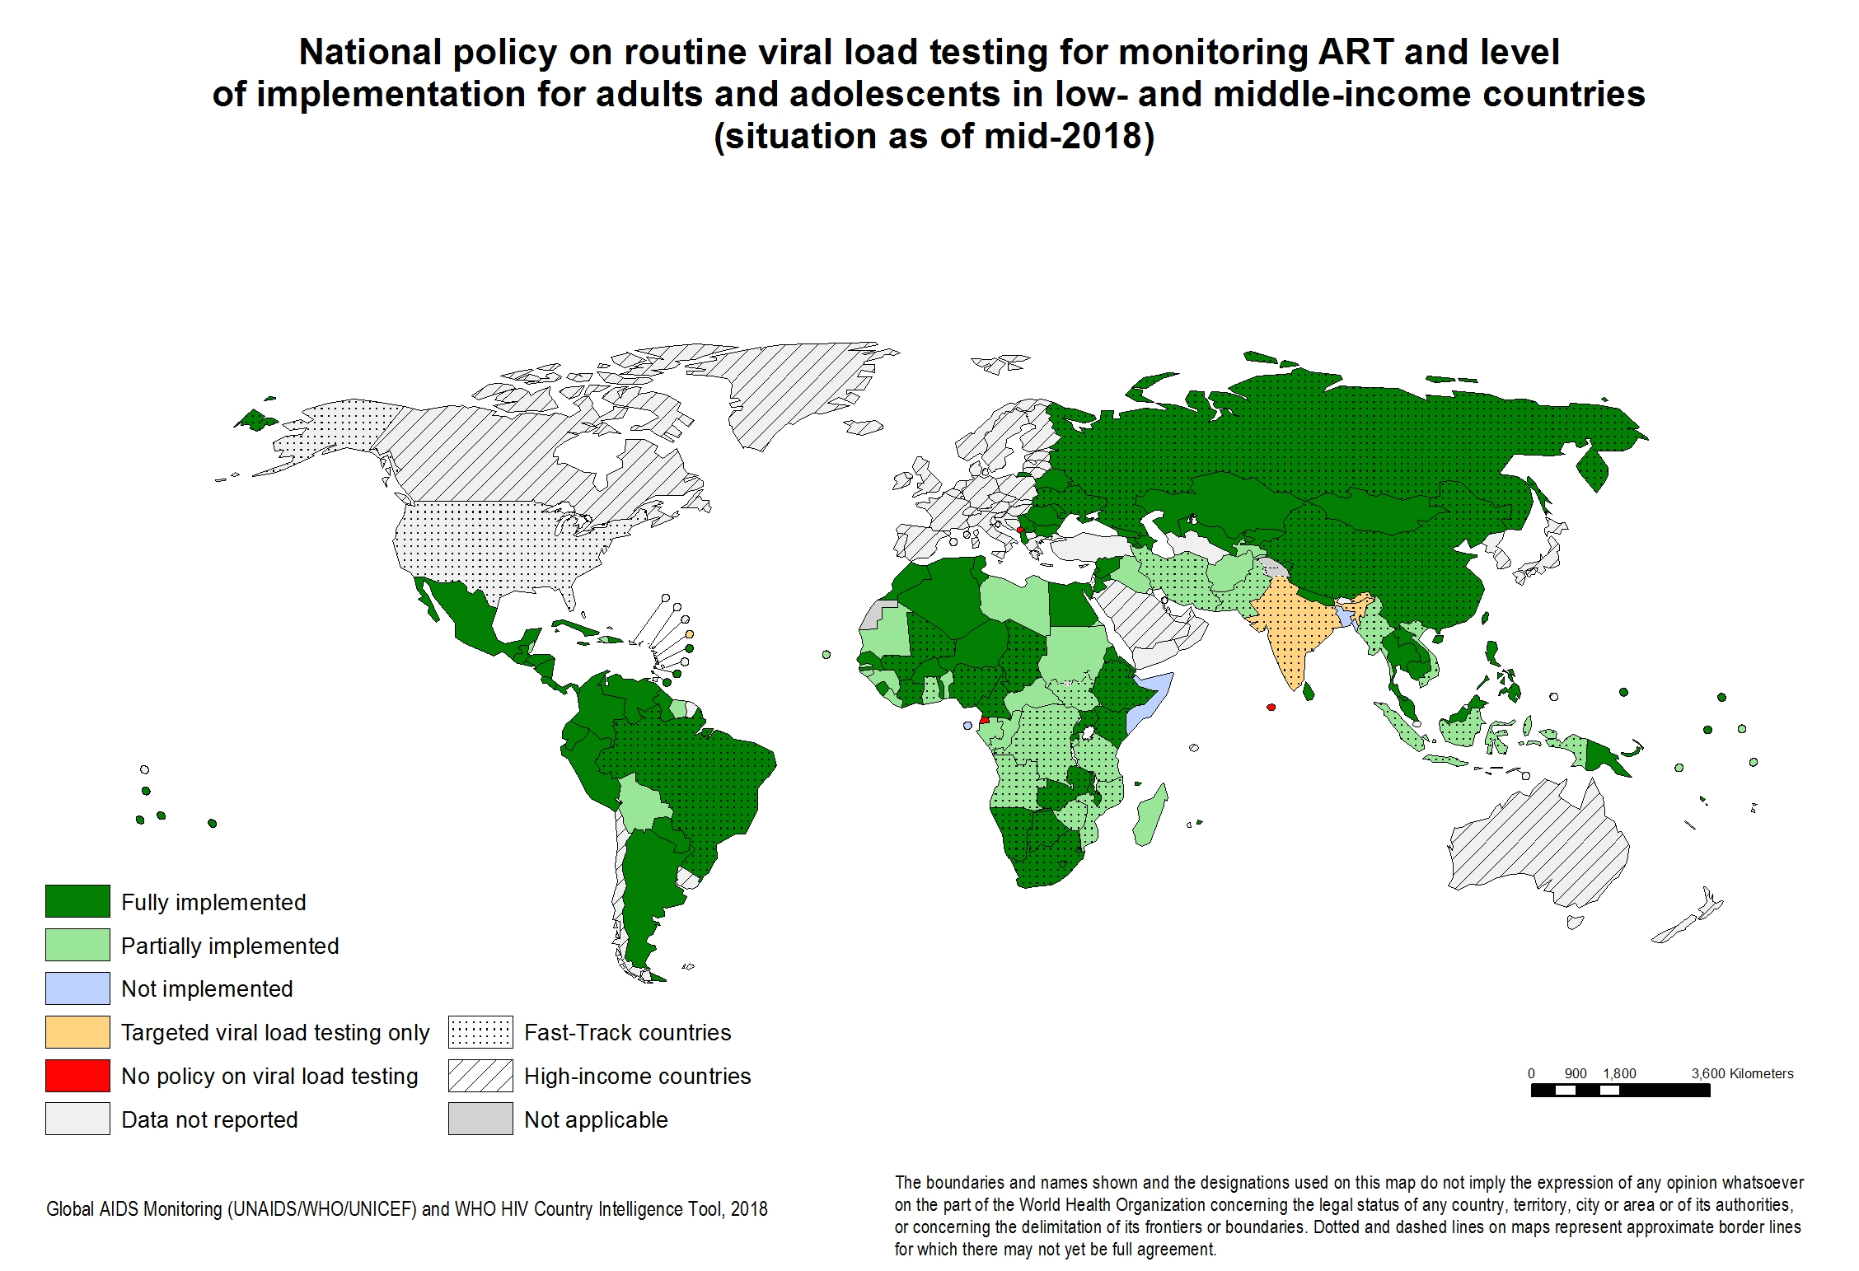
The momentum for VL scale-up has been building for a number of years

Slide 6
Demand for VL testing has more than doubled since 2012 and is expected to reach nearly 30m by 2022 as more countries scale up VL for routine monitoring, facilitated by DBS and POC
Use of DBS recommended by WHO
Roche Global Access Program launched
Recommended by WHO as a preferred method
Source: Consolidated forecast presented at AMDS meeting, Geneva, March 2018

Slide 7
VL coverage in LMICs reached over 50% in 2017, largely led by a few high-volume countries
Need is estimated using projected ART patient numbers and testing guidelines. Where national guidelines are unknown, the WHO’s recommendations of 2 tests for new patients and 1 test for existing patients is used.
Source: CHAI projections of 19 high-burden countries (81% of people on ART in LMICs), supplemented by linear extrapolations of “Rest of World” by Avenir Health.

Slide 8
The cost of VL tests varies by countries, but substantially higher than CD4 tests
HIV VL cost¹ 2017
 | Country A | Country B | Country C | Country D | Country E
Ave. cost | $22.45 | $19.91 | $16.72 | $16.32 | $14.55
¹Calculation of all-inclusive equivalent includes: a) instrument placement, b) reagents and consumables, c) service and maintenance, d) freight and logistics according to the Delivered At Place (DAP) incoterm, e) controls and calibration, and f) errors and failures. The all-inclusive price does not include ancillary costs, for example those associated with sample collection, sample transport, laboratory staff time, laboratory infrastructure, generic lab supplies (e.g. primary collection tubes, disposable gloves, etc.), inventory management, or general administration and overhead costs.
8

Slide 9
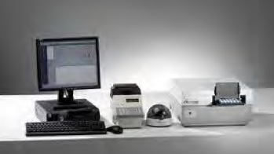
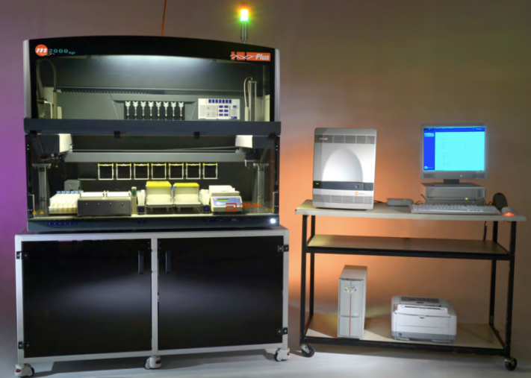
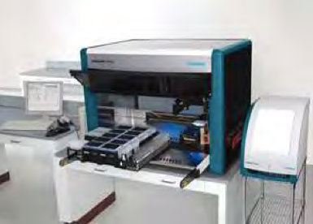
Increasing menu of options are available ranging from centralized to POC platforms with more in the development pipeline
Available on the market*
Centralized
POC
Pipeline products
SlipChip
NWGHF
* WHO qualified, CE-IVD, or SRA approved

Slide 10
Installed base of GeneXpert platforms may offer opportunities to expand VL testing to more decentralized settings
69% of 120 countries use less than 25% of their current GeneXpert installed base capacity for TB testing.
92% of 120 countries use less than 50% of installed base capacity for TB testing.
Impact on TB programs in the face of changing TB algorithm need to be carefully considered.
Based on internal analysis by CHAI of 2017 Cepheid TB sales data; figures are based on 16 tests per day (120min per test, 4 modules, 8 hours per day, 240 days per year); does not account for breakdowns or machines that are out of order

Slide 11
A few studies are in progress or planned to understand the impact of onsite VL testing
LIFE: Neonatal HIV early infant diagnosis (EID) versus standard of care EID – Impact on inFant hEalth (LIFE): a feasibility study of point-of care testing at birth vs at 6 weeks of age, on the uptake of ART and infant prophylaxis, and on rates of infant survival, morbidity and retention in care. | PW at delivery Infants at birth (EID) potential - Infants (VL) | Tanzania & Mozambique | Up to 5 years follow up (start 2019)
Point-of-care Viral Load Testing Among HIV-infected Adolescents in Haiti | Adolescents | Haiti [GHESKIO, Weill Cornell] | Complete Q1 2019
Evaluating the effect of point-of-care viral load monitoring at high volume HIV clinics | PLHIV on ART in need of 2nd VL, or other clinically indicated reason | Malawi | Complete. Analysis ongoing
STREAM Study (POC VL to enable Streamlined Care and Task Shifting) | Stable on ART (excl. Pregnant Women) | RSA (Durban) [CAPRISA, UW] | Complete Q3 2018
Reaching 90% Target of HIV Viral Suppression: The Role of Point-of-Care Viral Load Monitoring in Resource-Constrained Settings in Nigeria | PLHIV newly initiating ART | Nigeria [Jos Univ. & Harvard] | Complete Q2 2020
Rapid HIV Viral Load Monitoring in High Risk Patients In Uganda (RAPID-VL) | PLHIV on ART, including priority groups | Uganda | Complete Q4 2020

Slide 12
Conclusions
VL testing is a critical tool to support progress towards reaching global targets for treating PLHIV and preventing new infections
Strong momentum for scale-up is continuing, but there is still need to increase access in countries beyond “first-movers”
An increased range of product options are available that allow countries to implement VL testing both in centralized and decentralized settings
With multiplexing technologies, opportunities exist for more efficient use of finite resources across programs to rapidly increase access to a multitude of tests
Evidence is being generated to understand the impact and operational feasibility of decentralized VL testing
Countries have a wider array of options to implement VL testing to maximize access while meeting patients’ clinical needs

